Slide 1
Medicine in the Nineteenth Century
Year 11
History

Slide 2
Content
Medical knowledge and understanding at the beginning of the nineteenth century
Changes in the understanding of the causes of disease
Developments in surgery and hospital treatment
The work of Pasteur, Koch and Ehrlich
Medical knowledge and understanding at the end of the nineteenth century

Slide 3
Beginning of 19th Century
The nineteenth century was one of the most important eras in the history of medicine as many new cures and technologies were discovered. At the beginning, many poor people still lived in houses without proper sanitation, worked in dangerous factories and drank water from polluted rivers. By the end of the century, social conditions had improved, medicine was more complex, treatments were more widely offered and technology was more advanced along with many other improvements.

Slide 4
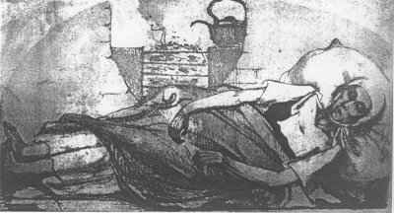
Twelve year old Ellen ‘Isabella’ Hazard, one of the first victims of cholera in England, October 1831.

Slide 5
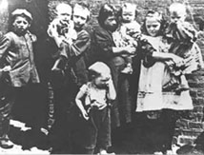
The nineteenth century saw a huge growth in the population of Great Britain.

Slide 6
The reason for this increase is not altogether clear. Various ideas have been put forward; larger families; more children surviving infancy; people living longer; immigration, especially large numbers of immigrants coming from Ireland fleeing the potato famine and the unemployment situation in their own country.

Slide 7
Child labour
Children were expected to help towards the family budget. They often worked long hours in dangerous jobs and in difficult situations for a very little wage.
For example, there were the climbing boys employed by the chimney sweeps; the little children who could scramble under machinery to retrieve cotton bobbins; boys and girls working down the coal mines, crawling through tunnels too narrow and low to take an adult. Some children worked as errand boys, crossing sweepers, shoe blacks, and they sold matches, flowers and other cheap goods

Slide 8
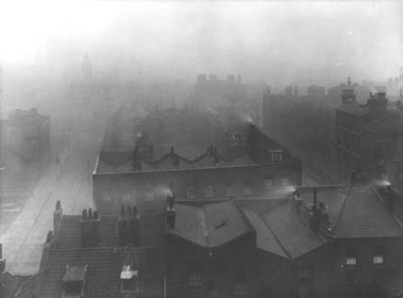
In the nineteenth century the air around London was heavily polluted by industrial smoke and factory pollution. The smog made the city a very dark and unhealthy place to live.

Slide 9
Attitudes to poverty
‘the poor were improvident, they wasted any money they had on drink and gambling’;
‘God had put people in their place in life and this must not be interfered with because the life after death was more important’

Slide 10
The Poor Law Amendment Act Of 1834
In the act it was decreed that external relief for the poor was to be stopped within two years, leaving these unfortunates with the choice of the workhouse or starvation. No able-bodied person was to receive money or any other help from the poor law authorities except in a workhouse. The legislation had been designed to root out the "undeserving poor".

Slide 11
In the first half of the century the medical world was raising the expectation that treatment of the body could become as exact a science as knowledge of the body. Throughout the land, much money and energy was being devoted to medical care and its study. Between 1801 and 1850 more university-educated men entered the profession in Great Britain (over eight thousand) than in all of previous history.

Slide 12
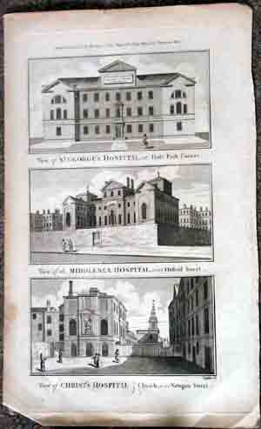

Slide 13
The number of practitioners was well keeping pace with the enormous growth in population. This same period saw a continuing expansion of hospital facilities. Over seventy special hospitals were founded between 1800 and 1860, among them the London Fever Hospital, the Kensington Children¹s Hospital, and the Free Cancer Hospital, Fulham. At the beginning of the century, hospitals in England and Wales were accommodating only an average of three thousand patients; fifty years later the number had grown to eight thousand.

Slide 14
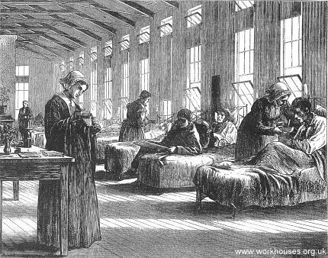
London Fever Hospital

Slide 15
The hospitals were providing not only more room for patients, but also expanded opportunities for the training of doctors. Especially after 1815, when the Apothecaries Act made mandatory for apprentices a half-year¹s experience in an infirmary, hospital, or dispensary, hospital surgeons began routinely to assume teaching duties and the larger teaching hospitals were inundated by students. These places became important centres for the study of morbid anatomy when, with the Anatomy Act of 1832, all unclaimed bodies were sent to them for dissection.

Slide 16
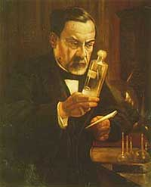

Slide 17
Anatomy Act 1832
The outcry over Burke and Hare led in 1832 to the passage by Parliament of the Anatomy Act. This stipulated that the bodies of those maintained by the state – the very poor who lived in workhouses – became the property of the anatomists after death, so long as they were not claimed by a relative within 48 hours. An Inspector of Anatomy, working for the Home Office, was appointed to administer the act. (more on that soon…)

Slide 18
Progress
Strides were being made not only in medical anatomy and physiology but also in pharmacology. Among the drugs isolated, concocted, or discovered between 1800 and 1840 were morphine, quinine, atropine, digitalis, codeine, and iodine. The nineteenth century was also a notable period in the identification, classification, and description of diseases.

Slide 19
Scarlet fever was clinically distinguished from diphtheria, syphilis from gonorrhoea, typhoid from typhus. The work of the great French physiologist Claude Bernard on the digestion established the connection between diabetes and glucose in the blood. The inventor of the stethoscope, R.-T.-H. Laënnec, wrote an important treatise in 1823 that first clearly distinguished such diseases as pleurisy, emphysema, bronchitis, and pneumonia.

Slide 20
The British public followed with a keen interest these developments which seemed to promise a healthy nation. And yet, in looking around them, they could clearly see that the promise was far from being realized. In actual practice all the researchers, family physicians, apothecaries and surgeons -- the whole of the medical profession -- provided scant help in curing those diseases of which Victorians had been made so vividly aware.

Slide 21
Burke and Hare
There were plenty of trainee surgeons, but they had nothing to train on. It was possible to get hold of bodies in the 18th century, but public executions provided the only legitimate source of corpses, and it was not easy for students of anatomy to claim the bodies.

Slide 22
The family of the condemned man would usually try to get the body back as soon as possible, since in some cases it was possible to revive a hanged man. In any case, there remained a strong belief that in order to stand a chance of redemption, a corpse should be left intact. Dissection was equivalent to damnation.

Slide 23
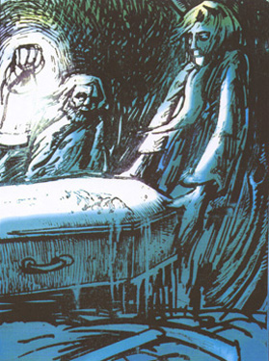
There were simply not enough bodies supplied by the hangman's gallows to meet demand. Elsewhere in Europe, anatomy schools were allowed to take bodies from poor hospitals. In Britain, surgeons had to take more extreme measures.

Slide 24
Body Snatching
'Bodysnatching started to happen all over the place. Anatomists ... spawned a new profession: resurrection men.' These grave robbers became the scourge of the bereaved. Watchtowers were built within cemeteries so that people could keep an eye out for body snatchers. Some rich people were buried within mort-safes, fortress graves complete with walls and gates to keep the grave robbers out. Gangs of resurrection men competed for business as anatomists competed to find the best suppliers of fresh corpses. As demand grew, the quest for bodies became ever more desperate.

Slide 25
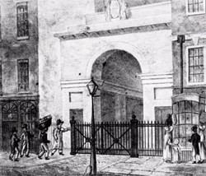
Body snatchers tried to sell corpses to King's anatomy classes, 1831.

Slide 26
Burke and Hare
Hard working Irish immigrants by day, scheming murderers by night - William Burke and William Hare were a unique pair of criminals who made a profit from providing dead bodies to the anatomy students of 19th century Edinburgh.

Slide 27
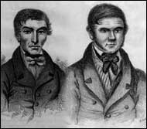
Edinburgh's population of university students and practicing anatomists created a unique market for fresh corpses that prompted Burke and Hare to enter into an illegal trade.

Slide 28
Murder for money is not an original concept by any means, but Burke and Hare had a new perspective on killing for financial gain. Unusually, they had little interest in the wealth of their victims, all they needed was a fresh corpse to sell.

Slide 29
In 1827, one of Hare's lodgers, an old man named Donald, fell ill and died. His death was of no real concern to Hare except that Donald owed him £4 in rent. Such was Hare's anger that he began to consider how the dead man could pay off his debt. Aware of the demand for corpses by anatomists, Hare hatched a plan.

Slide 30
On the day of the funeral, Burke and Hare took Donald's body from the coffin and replaced it with a sack of bark. Later in the day they removed the body from the house and took it to the anatomy offices of Professor Robert Knox. They were asked to return after nightfall and on doing so, they were paid 7 pounds 10 shillings for their efforts.

Slide 31
This ready cash made the pair contemplate a risky, but ultimately effortless, moneymaking scheme. Grave robbing was labour intensive and the quality or freshness of a corpse was not guaranteed. However, committing the murder themselves would be an easy way to ensure the supply of fresh quality corpses for sale.
They didn't have to look very far for their first victim. A murderous spree started!

Slide 32
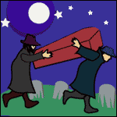
http://www.bbc.co.uk/dna/h2g2/classic/A702802

Slide 33
This powerpoint was kindly donated to www.worldofteaching.com
http://www.worldofteaching.com is home to over a thousand powerpoints submitted by teachers. This is a completely free site and requires no registration. Please visit and I hope it will help in your teaching.

